Slide 1
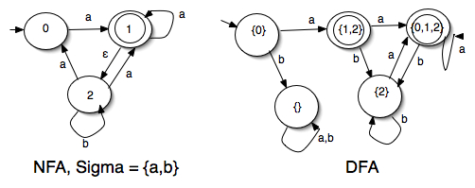
NFA-DFA Equivalence
Course Instructor: Mr. Hashim Ayub

Slide 2
NFA-DFA Equivalence
YouTube Lectures (Channel: Tayyaba Zaheer)
(TheAutoForm-Construct NFA Using JFlap) https://www.youtube.com/watch?v=e0jHJOdR3cw
(TheAutoForm-NFA DFA Equivalence) https://www.youtube.com/watch?v=x61q8sSxzJY

Slide 3
Recap
is accepted by the NFA:
“accept”
“reject”
because this
computation
accepts
this computation
is ignored

Slide 4
Recap
Language accepted:

Slide 5
NFAs express languages easier than DFAs
Are they Equivalent?
NFA
DFA

Slide 6
Equivalence of Machines
Definition:
Machine is equivalent to machine
if

Slide 7
Example of equivalent machines
NFA
DFA

Slide 8
Theorem:
Languages
accepted
by NFAs
Regular
Languages
Languages
accepted
by DFAs
NFAs and DFAs accept the same set of languages

Slide 9
Proof:
we only need to show
Languages
accepted
by NFAs
Regular
Languages
AND
Languages
accepted
by NFAs
Regular
Languages

Slide 10
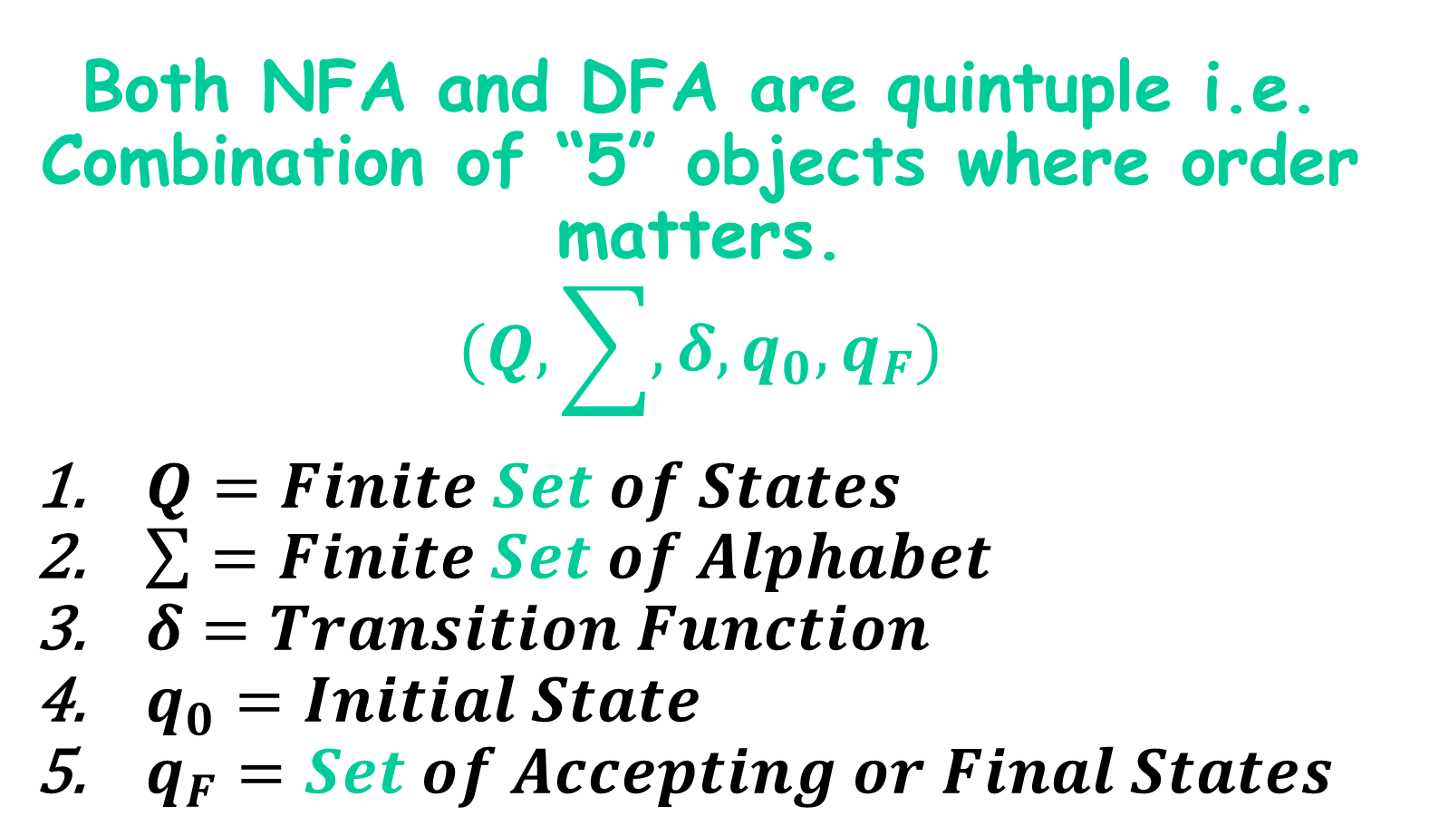
NFA DFA Equivalence
Both NFA and DFA are quintuple i.e. Combination of “5” objects where order matters.
$$(Q,\sum{,δ,q_{0},q_{F}})$$
$Q=Finite Set of States$
$\sum{=Finite Set of Alphabet}$
$δ=Transition Function$
$q_{0}=Initial State$
$q_{F}=Set of Accepting or Final States$

Slide 11
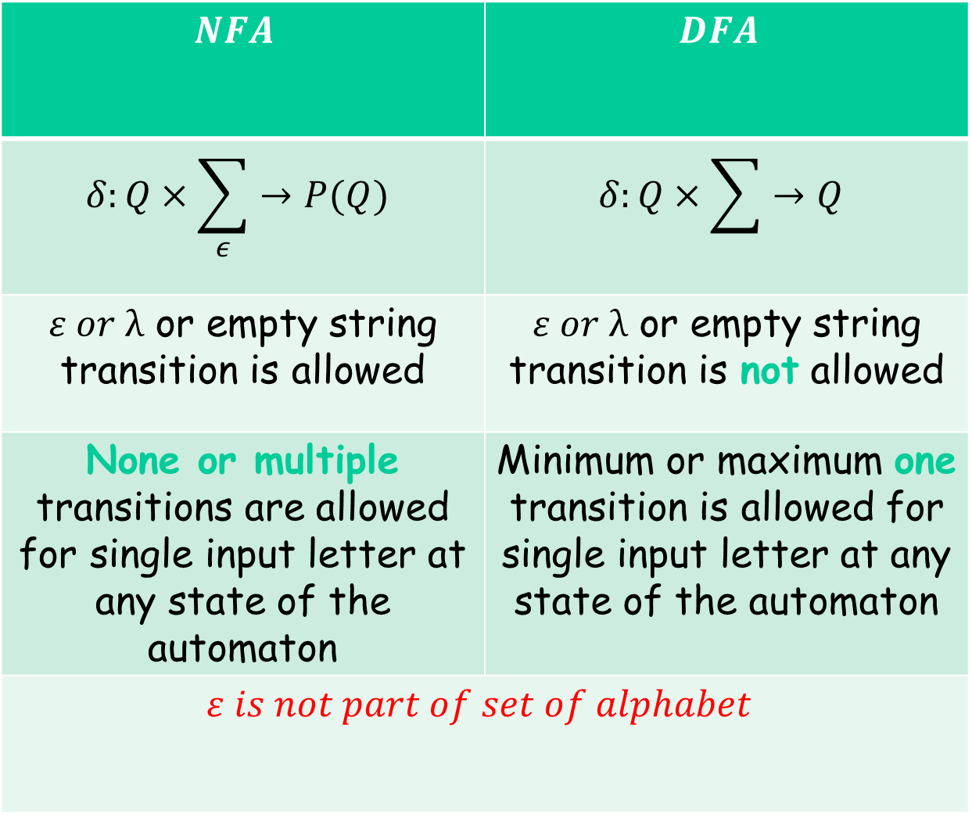
NFA Vs. DFA
$$NFA$$ | $$DFA$$
$$δ:Q×\sum_{ε}{→P(Q)}$$ | $$δ:Q×\sum{→Q}$$
$ε or λ$ or empty string transition is allowed | $ε or λ$ or empty string transition is not allowed
None or multiple transitions are allowed for single input letter at any state of the automaton | Minimum or maximum one transition is allowed for single input letter at any state of the automaton
$$ε is not part of set of alphabet$$

Slide 12
Proof-Step 1
Languages
accepted
by NFAs
Regular
Languages
Every DFA is trivially an NFA
Any language accepted by a DFA
is also accepted by an NFA

Slide 13
Proof-Step 2
Languages
accepted
by NFAs
Regular
Languages
Any NFA can be converted to an
equivalent DFA
Any language accepted by an NFA
is also accepted by a DFA

Slide 14
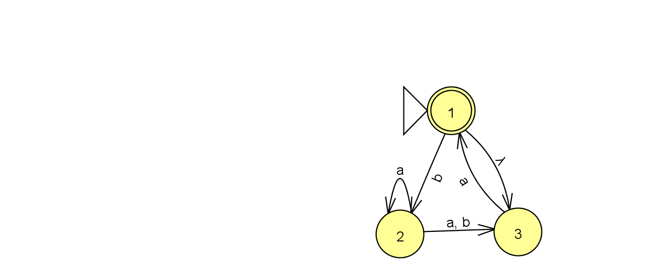

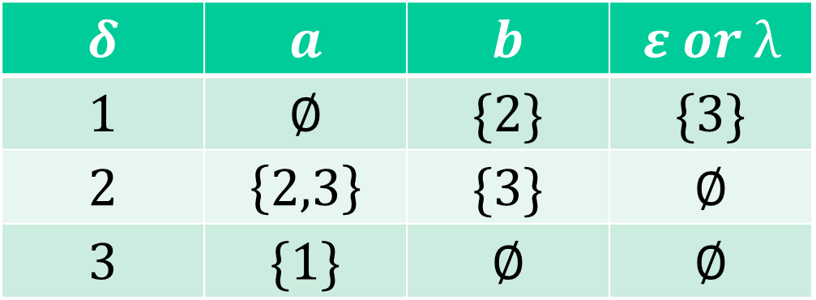
NFA
Set of States $Q=\left\{1,2,3\right\}$
Set of Alphabet $\sum{= \{a,b\}}$
$δ:Q×\sum_{ε}{→P(Q)}$ OR$δ:Q×\sum_{ε}{→2^{Q}}$
Initial State $q_{0}=1$
Set of Final States $q_{F}=\{1\}$
$$δ$$ | $$a$$ | $$b$$ | $$ε or λ$$
$$1$$ | $$∅$$ | $$\{2\}$$ | $$\{3\}$$
$$2$$ | $$\left\{2,3\right\}$$ | $$\{3\}$$ | $$∅$$
$$3$$ | $$\{1\}$$ | $$∅$$ | $$∅$$

Slide 15
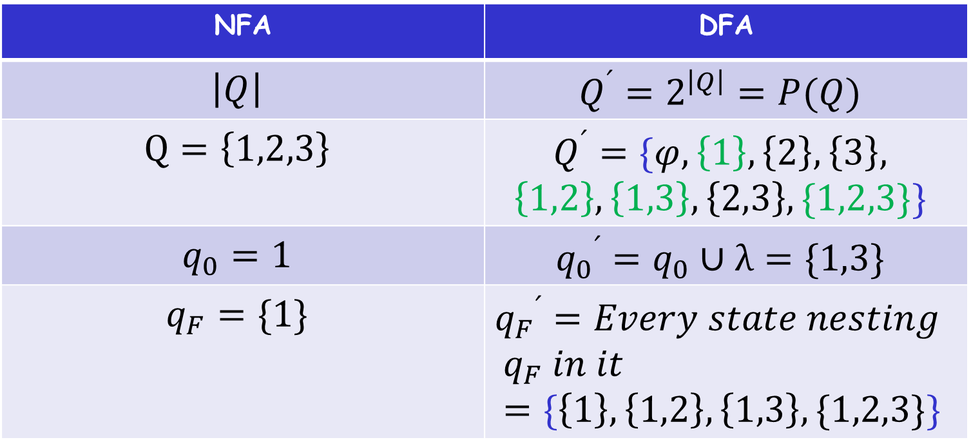
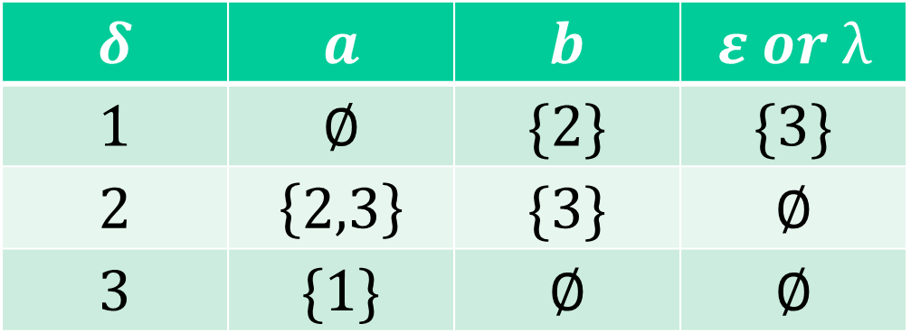
$$δ$$ | $$a$$ | $$b$$ | $$ε or λ$$
$$1$$ | $$∅$$ | $$\{2\}$$ | $$\{3\}$$
$$2$$ | $$\left\{2,3\right\}$$ | $$\{3\}$$ | $$∅$$
$$3$$ | $$\{1\}$$ | $$∅$$ | $$∅$$
NFA | DFA
$$\left|Q\right|$$ | $$Q^{՛}=2^{\left|Q\right|}=P(Q)$$
$$Q=\left\{1,2,3\right\}$$ | $$Q^{՛}=\{φ,\left\{1\right\},\left\{2\right\},\left\{3\right\},$$ $$\left\{1,2\right\},\left\{1,3\right\},\left\{2,3\right\},\{1,2,3\}\}$$
$$q_{0}=1$$ | $${q_{0}}^{՛}=q_{0}∪λ=\{1,3\}$$
$$q_{F}=\{1\}$$ | $${q_{F}}^{՛}=Every state nesting$$ $$q_{F} in it=\{\left\{1\right\},\left\{1,2\right\},\left\{1,3\right\},\{1,2,3\}\}$$

Slide 16
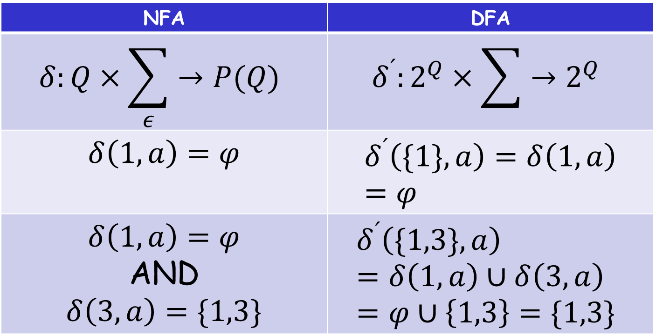
$$δ$$ | $$a$$ | $$b$$ | $$ε or λ$$
$$1$$ | $$∅$$ | $$\{2\}$$ | $$\{3\}$$
$$2$$ | $$\left\{2,3\right\}$$ | $$\{3\}$$ | $$∅$$
$$3$$ | $$\{1\}$$ | $$∅$$ | $$∅$$
NFA | DFA
$$δ:Q×\sum_{ε}{→P(Q)}$$ | $$δ^{՛}:2^{Q}×\sum{→2^{Q}}$$
$δ\left(1,a\right)=φ$ | $$δ^{՛}\left(\{1\},a\right)=δ\left(1,a\right)=φ$$
$δ\left(1,a\right)=φ$ AND $δ\left(3,a\right)=\{1,3\}$ | $$δ^{՛}\left(\{1,3\},a\right)=δ\left(1,a\right)∪δ\left(3,a\right)=φ∪\left\{1,3\right\}=\{1,3\}$$

Slide 17
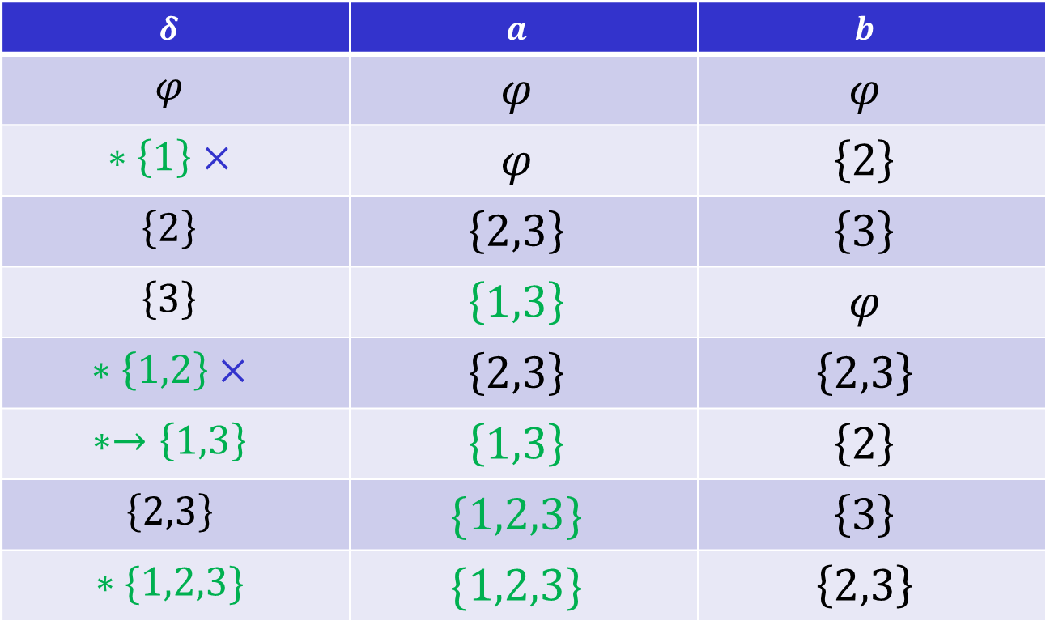
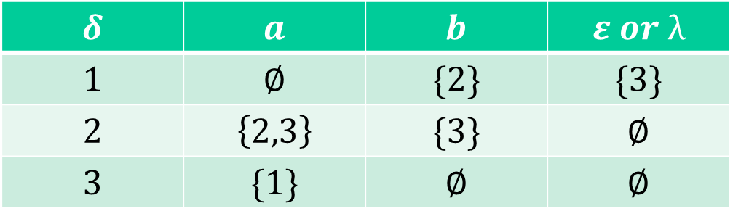
$$δ$$ | $$a$$ | $$b$$ | $$ε or λ$$
$$1$$ | $$∅$$ | $$\{2\}$$ | $$\{3\}$$
$$2$$ | $$\left\{2,3\right\}$$ | $$\{3\}$$ | $$∅$$
$$3$$ | $$\{1\}$$ | $$∅$$ | $$∅$$
$$δ$$ | $$a$$ | $$b$$
$$φ$$ | $$φ$$ | $$φ$$
$$∗\left\{1\right\}×$$ | $$φ$$ | $$\left\{2\right\}$$
$$\left\{2\right\}$$ | $$\left\{2,3\right\}$$ | $$\left\{3\right\}$$
$$\left\{3\right\}$$ | $$\left\{1,3\right\}$$ | $$φ$$
$$∗\left\{1,2\right\}×$$ | $$\left\{2,3\right\}$$ | $$\left\{2,3\right\}$$
$$∗→\left\{1,3\right\}$$ | $$\left\{1,3\right\}$$ | $$\left\{2\right\}$$
$$\left\{2,3\right\}$$ | $$\{1,2,3\}$$ | $$\left\{3\right\}$$
$$∗\{1,2,3\}$$ | $$\{1,2,3\}$$ | $$\left\{2,3\right\}$$

Slide 18
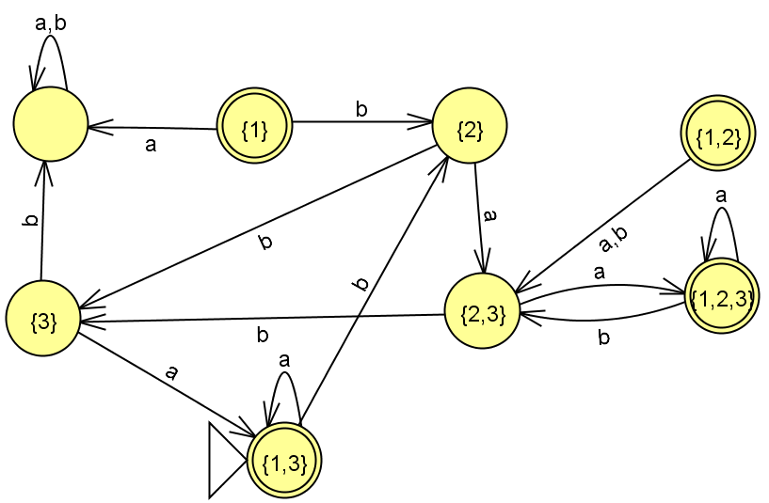
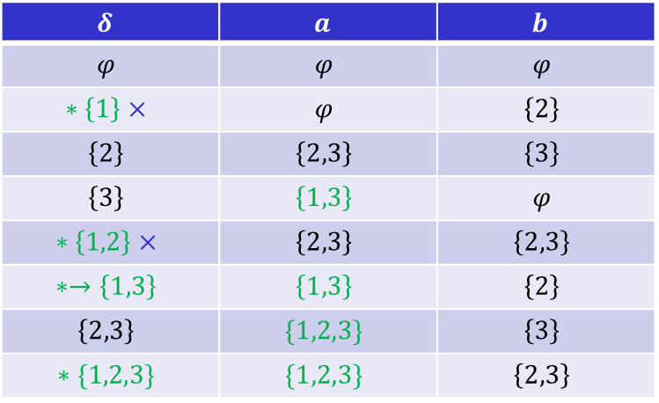

$$δ$$ | $$a$$ | $$b$$
$$φ$$ | $$φ$$ | $$φ$$
$$∗\left\{1\right\}×$$ | $$φ$$ | $$\left\{2\right\}$$
$$\left\{2\right\}$$ | $$\left\{2,3\right\}$$ | $$\left\{3\right\}$$
$$\left\{3\right\}$$ | $$\left\{1,3\right\}$$ | $$φ$$
$$∗\left\{1,2\right\}×$$ | $$\left\{2,3\right\}$$ | $$\left\{2,3\right\}$$
$$∗→\left\{1,3\right\}$$ | $$\left\{1,3\right\}$$ | $$\left\{2\right\}$$
$$\left\{2,3\right\}$$ | $$\{1,2,3\}$$ | $$\left\{3\right\}$$
$$∗\{1,2,3\}$$ | $$\{1,2,3\}$$ | $$\left\{2,3\right\}$$
$$φ$$

Slide 19
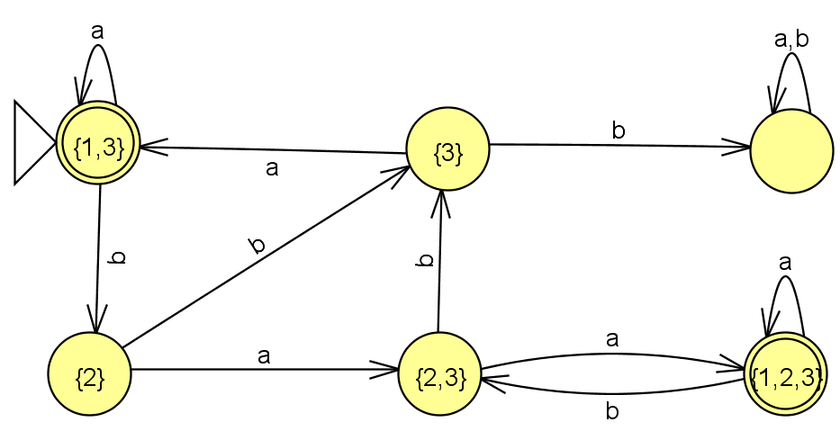

$$δ$$ | $$a$$ | $$b$$
$$φ$$ | $$φ$$ | $$φ$$
$$∗\left\{1\right\}×$$ | $$φ$$ | $$\left\{2\right\}$$
$$\left\{2\right\}$$ | $$\left\{2,3\right\}$$ | $$\left\{3\right\}$$
$$\left\{3\right\}$$ | $$\left\{1,3\right\}$$ | $$φ$$
$$∗\left\{1,2\right\}×$$ | $$\left\{2,3\right\}$$ | $$\left\{2,3\right\}$$
$$∗→\left\{1,3\right\}$$ | $$\left\{1,3\right\}$$ | $$\left\{2\right\}$$
$$\left\{2,3\right\}$$ | $$\{1,2,3\}$$ | $$\left\{3\right\}$$
$$∗\{1,2,3\}$$ | $$\{1,2,3\}$$ | $$\left\{2,3\right\}$$
$$φ$$

Slide 20
Conversion NFA to DFA
NFA
DFA

Slide 21
NFA
DFA

Slide 22
empty set
NFA
DFA
trap state

Slide 23
NFA
union
DFA

Slide 24
NFA
union
DFA

Slide 25
NFA
DFA
trap state

Slide 26
END OF CONSTRUCTION
NFA
DFA

Slide 27
Next, we shall study the
Summary: NFA and DFA are equivalent
General Conversion Procedure from NFA to a DFA

Slide 28
General Conversion Procedure
Input: an NFA
Output: an equivalent DFA
with

Slide 29
The NFA has states
The DFA has states from the power set

Slide 30
Conversion Procedure Steps
1. Initial state of NFA:
Initial state of DFA:
step

Slide 31
Example
NFA
DFA

Slide 32
step
2. For every DFA’s state
compute in the NFA
add transition to DFA
Union

Slide 33
Example
NFA
DFA

Slide 34
3. Repeat Step 2 for every state in DFA and symbols in alphabet until no more states can be added in the DFA
step

Slide 35
Example
NFA
DFA

Slide 36
step
4. For any DFA state
if some is accepting state in NFA
Then,
is accepting state in DFA

Slide 37
Example
NFA
DFA

Slide 38
Lemma:
If we convert NFA to DFA
then the two automata are equivalent:
Proof:
We only need to show:
AND

Slide 39
First we show:
We only need to prove:

Slide 40
NFA
Consider
symbols

Slide 41
symbol
denotes a possible sub-path like
symbol

Slide 42
We will show that if
NFA
then
DFA
state
label
state
label

Slide 43
More generally, we will show that if in :
(arbitrary string)
NFA
then
DFA

Slide 44
Proof by induction on
Induction Basis:
NFA
DFA
is true by construction of

Slide 45
Induction hypothesis:
Suppose that the following hold
NFA
DFA

Slide 46
Induction Step:
Then this is true by construction of
NFA
DFA

Slide 47
Therefore if
NFA
then
DFA

Slide 48
We have shown:
With a similar proof
we can show:
Therefore:
END OF LEMMA PROOF

Slide 49
Summary
NFA and DFA are equivalent
Every DFA is trivially an NFA
Every NFA can be converted to DFA
– This NFA to DFA Conversion can be done in four steps
Prof. Busch - LSU

Slide 50
Any Questions?
Have fun with learning!

